Slide 1


National Academic Depository

Slide 2
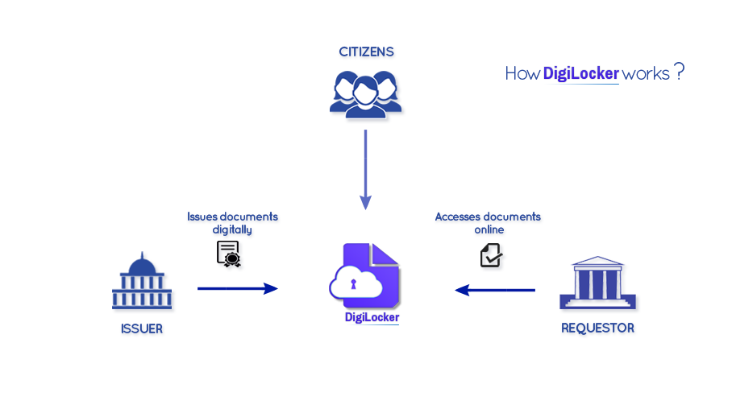

NAD Digilocker_System
Authentic documents directly from Issuers
(Election Commission)

Slide 3






NAD Product Differentiation Features
Standard templates for data upload and awards
Media upload facility for logos, student photos to be printed on digital awards
Click wrap agreement, with soft copy sent via email
Pre-population of University data in registration page for easy on boarding
Student record hashing for audit trail management
Online and Offline scrutiny of academic institutions for security
API based approach to create machine to machine data flow and bringing more automation.
Focus on User experience design ..to minimize the capacity building programme to participate
Focus on interoperability , global standards and Specification for creating a ecosystem of digital document exchange.

Slide 4







Process Flow
AI user visits NAD Portal
Authentication Depository
User Registration
Uploads student
data , photos
AI & User
Verification
AI publishes
awards
Student access awards
Sharing awards & Consent

